Slide 1

#LifeKoKaroLift
Data Science Program
‹#›

Slide 2


Module Name: EDA & Statistics
Course : Statistics
Lecture On : Statistics - Day - 5
Instructor :
‹#›

Slide 3
Today’s Agenda
Revision
Permutations, Combinations
Probability: Definition and Properties
Types of Events
Rules of Probability - Addition and Multiplication
Random Variables, Expected Value
Probability Without Experiment
Key Takeaways
Data Science Certification Program
‹#›

Slide 4

Revision
In previous session, we learnt about:
Numeric - Numeric Analysis
Correlation vs Causation
Numerical - Categorical Analysis
Categorical - Categorical Analysis
Multivariate Analysis

Slide 5
Permutations
Before we turn our focus to probability, it is important to understand some basic tools that form its essential building blocks.
One of the key things you need to master is the idea of the two major counting principles: permutations and combinations.
Knowing these two concepts will enable you to calculate the probability for a given scenario or events that you are interested in.
A permutation is a way of arranging a select group of objects in a way that the order is of significance.
For example,
When you plan to line up the top-order batsmen of a cricket team, you use permutation to find all the possible orders in which they can be lined up.

Slide 6
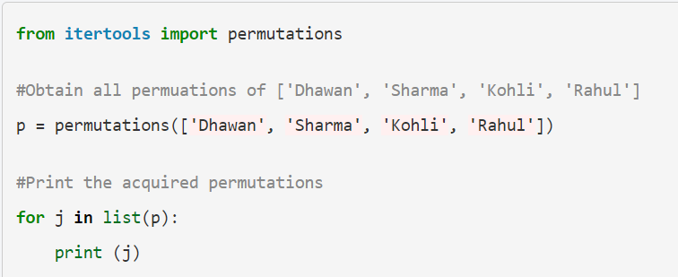
Permutations
You can use the following code to print all the permutations of an input list:

Slide 7
Permutations
The following is a list of some other examples where permutation is used to count the number of ways in which a particular sequence of events can occur:
Finding all possible four-letter words that can be formed using the alphabets R, E, A and D
Finding all possible ways in which the final league standings of the eight teams can be in an Indian Premier League (IPL) tournament
Finding all possible ways that a group of 10 people can be seated in a row in a cinema hall

Slide 8
Permutations
Generally speaking, if there are ‘n objects’ that are to be arranged among r available ‘spaces’, then the number of ways in which this task can be completed is n!/(n−r)!.
If there are n ‘spaces’ as well, then the number of ways would be just n!. Here, n! (pronounced as n factorial) is simply the product of all the numbers from n till 1 and is denoted with the following formula:

Slide 9
Combinations
The second important counting principle that you need to be aware of is the method of using combinations.
You had considered the ‘order’ to be an important factor when counting using the method of permutations.
However, in the case of combinations, you need not take the order into account while finding the number of ways to arrange a group of objects.
When you just have to choose some objects from a larger set and the order is of no significance, the rule of counting that you use is called combination.
For example,
Choosing three bowlers from a set of four bowlers, we not need to order them here.

Slide 10

Combinations
Some other examples of combinations are as follows:
The number of ways in which you can pick three letters from the word ‘UPGRAD’
The number of ways in which a team can win three matches in a league of five matches
The number of ways in which you can choose 13 cards from a deck of 52 cards
The formula for counting the number of ways to choose r objects out of a set of n objects is as follows:
Now, you might be wondering when to use permutations and when to use combinations.
One way to look at it is to check whether the order matters. Use the permutations formula if it does, and use the one for combinations if it does not.

Slide 11
Probability
Probability is simply how likely something is to happen.
Probability tells us about the likelihood of an outcome of the event when we are unsure about it.
Probability of an event = (No. of ways it can happen) / (total number of outcomes)
For Eg: Flipping a coin, we have two possible outcomes.Hence the probability of getting a heads would be:
P(H) = 1/2
Similarly, Probability of getting a 5 when rolling a dice would be:
P(5) = 1/6

Slide 12
Probability
For Eg: Flipping a coin, There are two possible outcomes.Hence the probability of getting a heads would be:
P(H) = 1/2
Similarly,Rolling a dice, There are six different outcomes.Probability of getting a 5 would be:
P(5) = 1/6
Additional Reading: Probability
Practice Questions: Simple Probability

Slide 13
Probability
Probability values have the following two major properties:
Probability values always lie in the range of 0 to 1:
The value is 0 in the case of an impossible event (like the probability of you being in Delhi and Mumbai at the same time) and 1 in the case of a sure event (like the probability of the sun rising in the east tomorrow).
The probabilities of all outcomes for an experiment always sum up to 1:
For example, there can be two outcomes in a coin toss: heads and tails. The probability of the outcomes is 0.5 each. Hence, the sum of the probabilities turns out to be 0.5 + 0.5 = 1.

Slide 14
Probability
Let’s learn a couple of definitions that are crucial for understanding probability.
Experiment: Essentially, any scenario for which you want to compute the probabilities is considered to be an experiment. It can be any of the following two types:
Deterministic: The outcome is the same every time.
Random: The outcome can take many possible values.
Sample space: A sample space is nothing but a list of all possible outcomes of a random experiment. It is denoted by S = {all the possible outcomes}. For example, in the coin toss example, the sample space S = {H, T}, where H = heads and T = tails.
Event: It is a subset, i.e., a part of the sample space that you want to be true for your probability experiment. For example, if in a coin toss you want heads to be the desired outcome, then the event becomes {H}. As you can see clearly, {H} is a part of {H, T}.

Slide 15
Types of Events
The two main categories of events that you need to know right now are independent events and disjoint or mutually exclusive events.
Let’s take a look at their formal definitions:
Independent events: If you have two or more events, and the occurrence of one event has no bearing whatsoever on the occurrence/s of the other event/s, then all the events are said to be independent of each other.
For example, the chances of rain in Bengaluru on a particular day have no effect on the chances of rain in Mumbai 10 days later. Hence, these two events are independent of each other.

Slide 16
Types of Events
2. Disjoint or mutually exclusive events: Now, two or more events are
mutually exclusive when they do not occur at the same time, i.e., when one
event occurs, the rest of the events do not occur.
For example, if a student has been assigned grade C for a particular subject in an exam, they cannot be awarded grade B for the same subject in the same exam. So, the events in which a student gets a grade of B and C for the same subject in the same exam are mutually exclusive or disjoint.

Slide 17
Types of Events
Two or more events cannot be independent and disjoint simultaneously. Two events can be either exclusively independent or exclusively disjoint.
Here are some examples to help you understand this better:
The events ‘Customer A buys the product’ and ‘Customer B buys the product’ are independent, whereas the events ‘Customer A buys the product’ and ‘Customer A does not buy the product’ are disjoint.
The events ‘You will win Lottery A’ and ‘You will win Lottery B’ are independent, whereas ‘You will win Lottery A’ and ‘You will not win Lottery A’ are disjoint events.

Slide 18
Rules of Probability – Addition
In the previous examples, we were always involved in finding the probability of a single event, For example:
The probability of getting an ace card from a deck of 52 cards
The probability of selecting three bowlers from a list of four
Now, what about two events occurring simultaneously? For example,
What would be the probability of selecting an ace card or a heart card from the deck?
How would this specific probability relate to the individual probabilities, i.e., the probability of getting a heart card separately and the probability of getting an ace card separately?
This is something that you will learn using the two important rules related to probability: addition and multiplication.

Slide 19
Rules of Probability – Addition
When you have the individual probabilities of two events A and B, denoted by P(A) and P(B), the addition rule states that the probability of either A or B occurring is given by: P(A∪B) = P(A) + P(B) - P(A∩B)
Where P(A∪B) denotes the probability that either event A or B occurs,
P(A) denotes the probability that only event A occurs,
P(B) denotes the probability that only event B occurs and
P(A∩B) denotes the probability that both events A and B occur simultaneously.
For disjoint events A and B, P(A∩B) = 0 since both cannot occur simultaneously. Hence, the formula can be rewritten as P(A∪B) = P(A) + P(B).

Slide 20
Rules of Probability – Multiplication
This rule applies only to independent events, about which you have already learnt. When event A is not dependent on event B and vice versa, they are known as independent events.
The multiplication rule allows us to compute the probabilities of both events occurring simultaneously, which is given as follows: P(A and B) = P(A)*P(B)
Now, this rule can be extended to multiple independent events, and all you need to do is multiply the respective probabilities of all the events to get the final probability of all of them occurring simultaneously.
For example, if you have four independent events A, B, C and D, then it will be as follows: P(A and B and C and D) = P(A)*P(B)*P(C)*P(D)

Slide 21
Rules of Probability – Multiplication
Both the addition rule and the multiplication rule allow you to compute the probabilities of the occurrence of multiple events.
However, there is a key difference between the two, which should help you decide when to use which rule.
The addition rule is generally used to find the probability of multiple events when either of the events can occur at that particular instance.
The multiplication rule is used to find the probability of multiple events when all the events need to occur simultaneously.

Slide 22
Random Variable
A Random Variable is a set of possible values from a random experiment.
A Random Variable has a whole set of values and it could take on any of those values, randomly.

Slide 23
Random Variable
For eg, Suppose a random variable X represents the sum of the resulting numbers after three dice are rolled.
In this case, X could be 3 (1 + 1+ 1), 18 (6 + 6 + 6), or somewhere between 3 and 18, since the highest number of a die is 6 and the lowest number is 1.
Additional Reading:Random Variable

Slide 24
Random Variable
Example: Let Random Variable X represent the sum of two dice.
Then, the probability distribution of X is as follows:
X | 2 | 3 | 4 | 5 | 6 | 7 | 8 | 9 | 10 | 11 | 12
P(X) | 1/36 | 2/36 | 3/36 | 4/36 | 5/36 | 6/36 | 5/36 | 4/36 | 3/36 | 2/36 | 1/36

Slide 25
Probability Distribution
A probability distribution is a function that describes the likelihood of obtaining the possible values that a random variable can assume.
Suppose you draw a random sample and measure the heights of the subjects. As you measure heights, you can create a distribution of heights.
This type of distribution is useful when you need to know which outcomes are most likely, the spread of potential values, and the likelihood of different results.
For a single random variable, Probability Distribution has the following two types:
Discrete probability distributions for discrete variables
Probability density functions for continuous variables

Slide 26
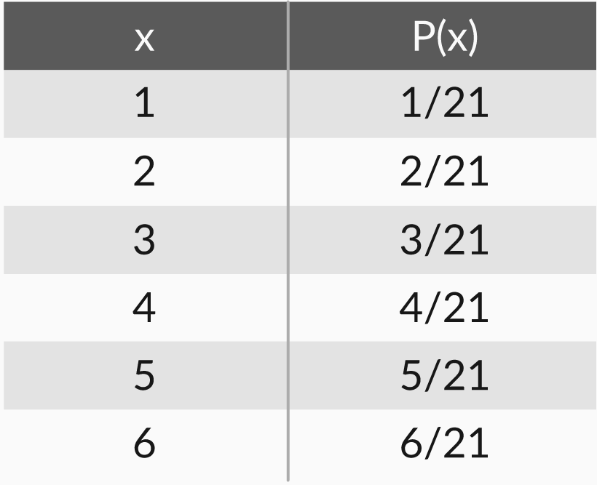
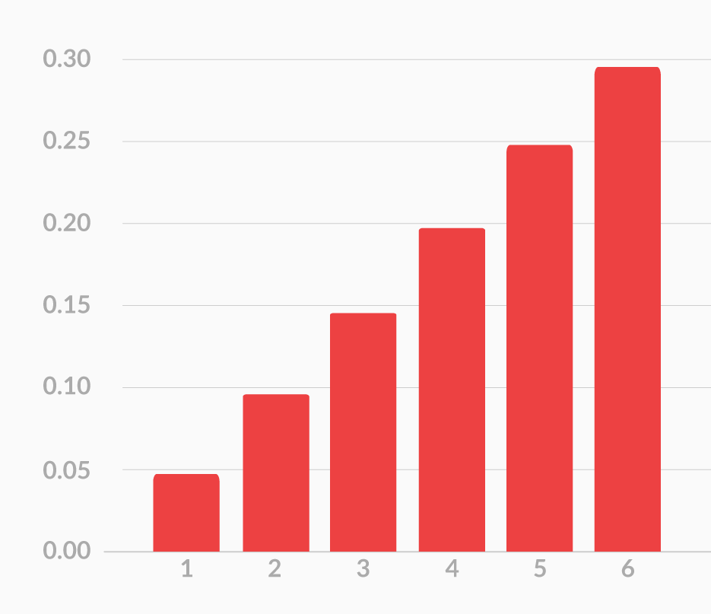
Probability Distribution
A probability distribution is ANY form of representation that tells us the probability for all possible values of X. It could be any of the following:
In a complete probability distribution, there are no negative values, and the total of all probability values adds up to 1.
P(x) = x/21
(for x = 1, 2, 3, 4, 5 and 6)
A table
A Chart
An Equation

Slide 27
Probability Distribution
For Eg: The number of adults living in homes on a randomly selected city block is described by the following probability distribution.
What is the probability that 4 or more adults reside at a randomly selected home?
The correct answer is 0.10. The sum of all the probabilities in a Probability Distribution is equal to 1. Therefore, the probability that four or more adults reside in a home is equal to 1 - (0.25 + 0.50 + 0.15) or 0.10.
Additional Reading: Probability Distribution
Number of adults, | Probability,
X | P(X)
1 | 0.25
2 | 0.5
3 | 0.15
4 or more | ???

Slide 28
Expected Value
Expected value is the average value of a random variable over a large number of experiments.
Any given random variable contains a wealth of information. It can have many (or infinite) possible outcomes, and each outcome could have different likelihood.
The expected value is a way to summarize all this information in a single numerical value.

Slide 29
Expected Value
For example,
if you take a 20 question multiple-choice test with A,B,C,D as the answers, and you guess all “A”, then you can expect to get 25% right (5 out of 20).
The math behind this kind of expected value is:
The probability (P) of getting a question right if you guess: 0.25
The number of questions on the test (n)*: 20
P(X) * n = .25 x 20 = 5
Practice Exercise: Expected Value Practice
Additional Reading: Expected Value Reading

Slide 30
Probability Without Experiment
In the last session, we found the probability for certain events by conducting experiments.
Specifically, we created a histogram or, in other words, a frequency distribution. Then, using this histogram, we created the probability distribution.
However, this is a lengthy process.
If we perform a certain experiment many more times, then the resulting experimental probability distribution would have been even closer to the theoretical one.

Slide 31
Probability Without Experiment
For Eg:
if you're asked for the probability of getting heads after flipping a coin 10 times, the experimental probability will be the number of times you got heads after flipping a coin 10 times. Let's say that you got 6 heads out of your 10 throws. Then your experimental probability is 6/10, or 60%.
For theoretical probability, it doesn't require you to actually do the experiment and then look at the results. Instead, the theoretical probability is what you expect to happen in an experiment (the expected probability). This is the theoretical probability definition.
This helps to find probability for various combinations without much efforts
Additional Reading: Comparing experimental and theoretical probability

Slide 32
Key Takeaway
Revision
Permutations, Combinations
Probability: Definition and Properties
Types of Events
Rules of Probability - Addition and Multiplication
Random Variables, Expected Value
Probability Without Experiment
Key Takeaways
Data Science Certification Program
‹#›

Slide 33
#LifeKoKaroLift
Thank You!
‹#›

